Slide 1
Team Members & Roles
SAV199
Muthulakshmi D- TEAM LEADER
Dharunyadevi S
Divya M
Harini
Gajalakshmi V

Slide 2
PROBLEM STATEMENT:
Real-World Challenge:
Despite the rising urgency of climate change and environmental degradation, environmental education remains largely theoretical in many Indian schools and colleges. Students are often taught textbook-based content with little emphasis on real-world application, local ecological issues, or personal responsibility.
There is a lack of engaging tools that motivate students to adopt eco-friendly practices or understand the direct consequences of their lifestyle choices. Traditional methods fail to instill sustainable habits or inspire youth participation in local environmental efforts.

Slide 3
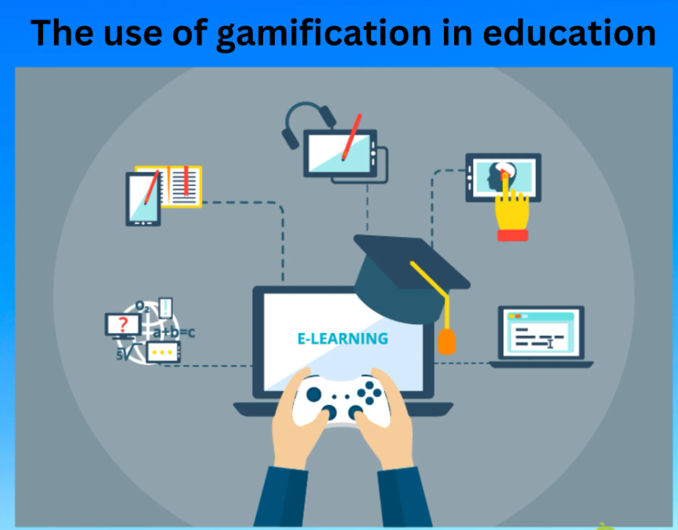
GAMIFIED EDUCATION
Increase Engagement & Motivation – Traditional lessons are boring; gamification makes learning fun, interactive, and rewarding.
Promote Real-World Impact – Students actively practice eco-friendly habits through challenges, quizzes, and simulations.

Slide 4
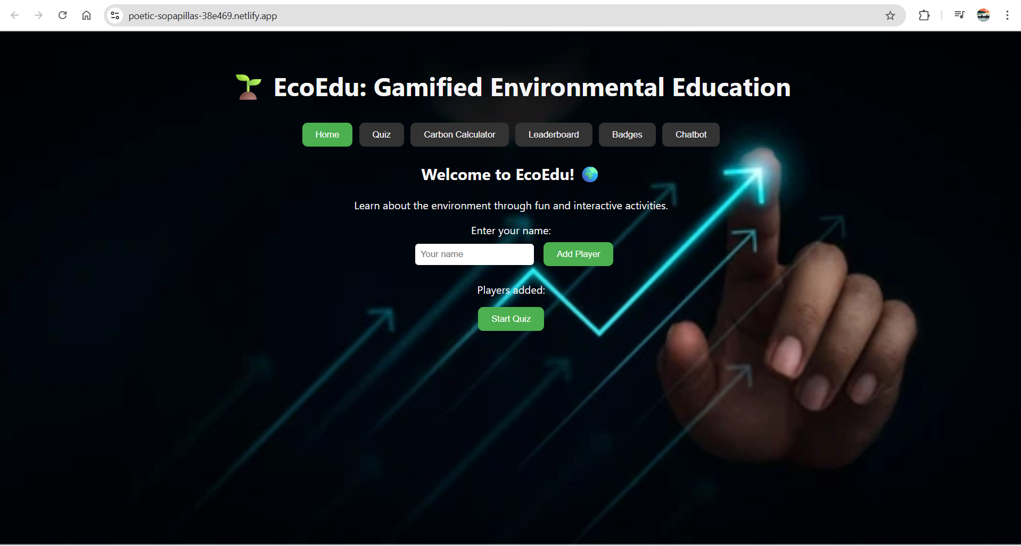
Solution
Our Idea:
How It Solves the Problem:
Engaging & Fun: Turns boring lessons into interactive quizzes, challenges, and games.
Promotes Eco-Friendly Habits: Encourages students to practice sustainability in real life.
Easy & Accessible: Works on mobile or web for schools, colleges, and homes.

Slide 5
Why It’s Important:
Raises Awareness: Teaches students about pollution, recycling, climate change, and sustainability.
Builds Habits Early: Encourages eco-friendly practices from a young age.
Bridges Theory and Practice: Helps students see the real-world impact of their actions.
Reduces Environmental Impact: Educated students can make choices that help protect the planet.

Slide 6
Wow factors
Raises Awareness: Teaches students about pollution, recycling, climate change, and sustainability.
Builds Habits Early: Encourages eco-friendly practices from a young age.
Bridges Theory and Practice: Helps students see the real-world impact of their actions.
Reduces Environmental Impact: Educated students can make choices that help protect the planet.

Slide 7
Learnings during the Datathon
Teamwork & Collaboration: Worked effectively with peers.
Practical Problem-Solving: Built solutions under time pressure.
Technical & Creative Skills: Applied AI, gamification, and UX design.
User-Centric Approach: Learned the importance of engagement and accessibility.

